Slide 1
COVID-19 Safety Management Systems requirements for organizations

Slide 2
Overview
What is SLS 1672: 2020?
Why SLS 1672: 2020?
Who should comply with this standard?
Advantages of SLS 1672: 2020

Slide 3
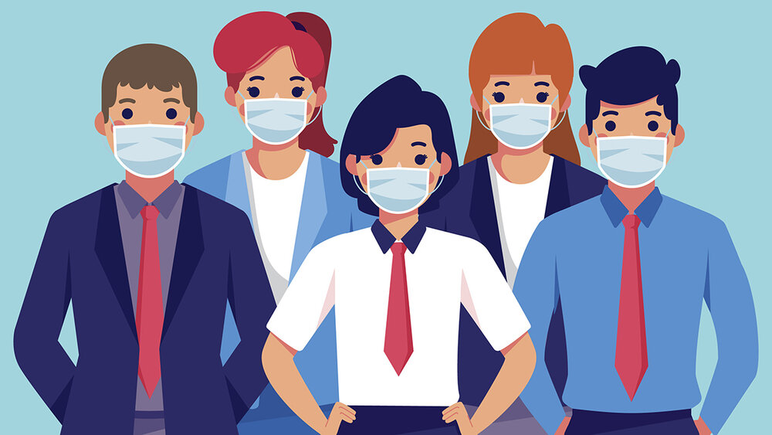
What is SLS 1672: 2020?
Sri Lanka Standard (SLS) 1672 is the newly introduced standard which was published by Council of the Sri Lanka Standards Institution on 2020-05-20.
This standard presents COVID-19 safety management system requirements for organizations.

Slide 4
Why SLS 1672: 2020?
COVID is highly contagious and deadly.
COVID-19 safety management system preserves the safety of your organization.

Slide 5
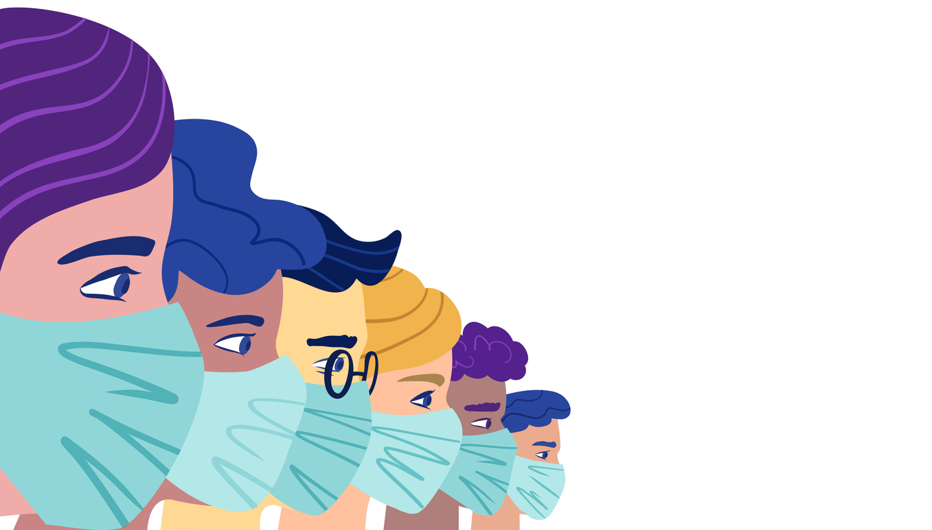
Who should comply with this standard?
This standard is applicable to all organizations, regardless of type, size or nature.

Slide 6
Advantages of SLS 1672: 2020
Control of COVID risk
Global recognition
Attract customers and business
Gives a co-competence to outperform
Brings confidence to staff, and other interested parties to be with you

Slide 7
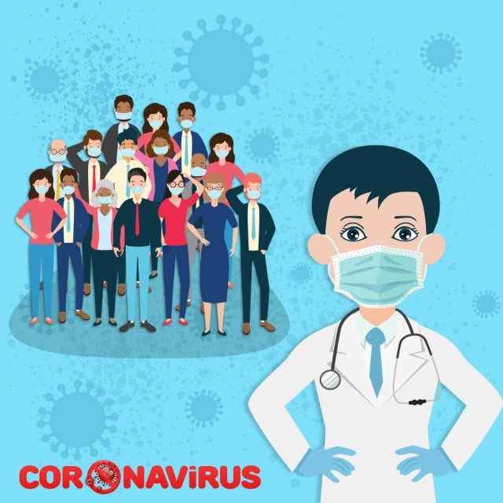
Thank you!
Prevention is always better than cure!!!

